Slide 1


Make an impact in meetings, calls, networking events, informal events
Be aware of your personal brand and its impact on others.
Influence others through reasoning and building positive relationships
Use multiple colors of your personality to get the point across

Slide 2
Your need as we understand
Genpact GOLD (Genpact Operations Leadership Development) is a high profile, high visibility learning journey for Band 4 Operations leaders at Genpact. (Managers to Sr. Managers population) Genpact selects 85 odd leaders from 900 applications to be a part of this 18 month leadership journey. The participants are selected based on an online assessment and their last 3 appraisals. A GOLD batch, starts in January and graduates in May, the following year.
Background
MaynardLeigh has been hired to lead the first phase of the GOLD journey this year, where 85 participants have been selected from across the globe (With different nationalities) who travel to Hyderabad for the phase1. Some of the scenarios you’d like us to work on are-
Elevator Pitches, Being able to hold a spontaneous conversation with a leader, being concise- knowing how much to share with whom, holding difficult conversations, being able to network.
Situation
Genpact wants these (GOLD) leaders to stand out from the rest of the population. The participants are given a Golden Lanyard, to differentiate them on the floor- the need is to stand out even without that. As a part of the journey, they get to work with different teams and are also given an opportunity to change their roles, the leaders should make their presence felt wherever they go.
Opportunity
Genpact has hired MaynardLeigh to deliver a bespoke solution which could really bring about a change in the participants. You want us to create an experiential journey to give ample opportunities for the participants to practice, rehearse and get feedback.
Need
3

Slide 3
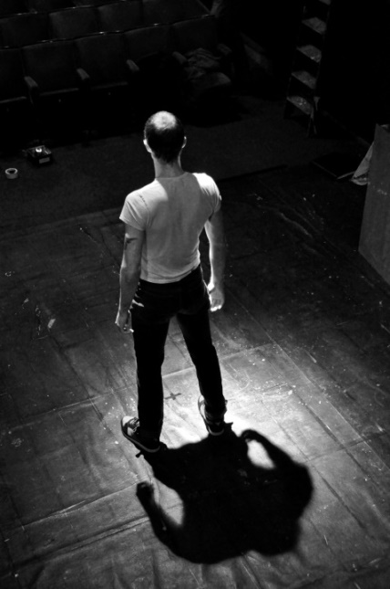
The ABC of Charisma
Actors have been known for ages to have ‘Star like quality’ which leads them to exude confidence and move an entire auditorium full of people. They have an inherent ability to use a wide range of emotions to be able to make the audience feel what the script demands of them.
Our directors knew that “The inner substance speaks much louder and clearer than the outer masks” Hence, they would spend most time having the actor connect with the character, its thoughts, it’s body and spend little time on the schematics, costumes etc.
Aim
Every communication has a purpose.
What’s the impression you want to leave your audience with?
Being yourself
-Are you bringing your whole self or are their parts of your personality behind
-Using your natural charisma and gravitas
Chemistry
-Focus of attention
-Building relations
- Emotional and social intelligence
-Impact in your interactions & presentations.

Slide 4
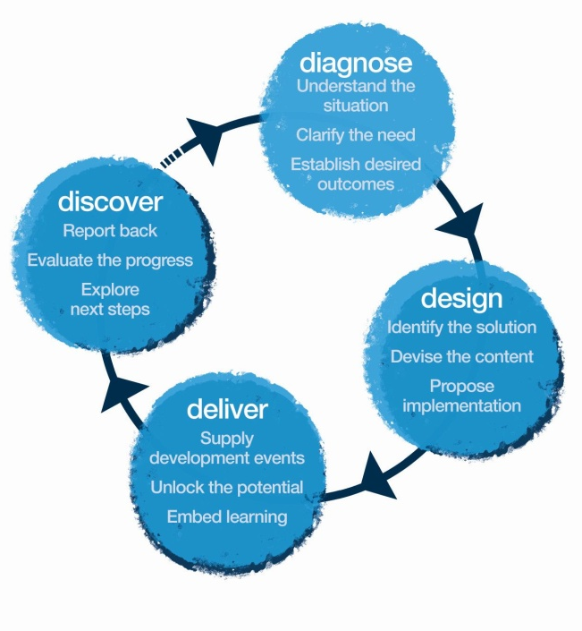
Our Approach
Methodology
We create experiential learning solutions using principles from Theatre Psychology and L&D tools.

Slide 5
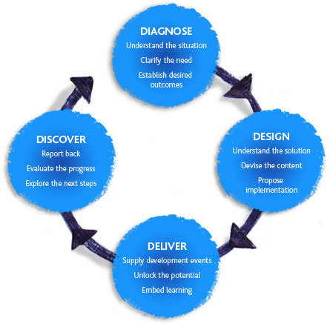

Diagnosis
We propose to also spend two days in your office to meet few target participants, their leaders, HR Stakeholders to customize the design according to your need. All the combined inputs will be incorporated into the design and make it more relevant.
We would need information on:
Current State - what’s working, areas of strengths, challenges, etc.
Current scenarios of their interactions with the stakeholders, customers.
Gather anecdotes, examples & situations relevant for the workshop.
Get to know their work flow

Slide 6

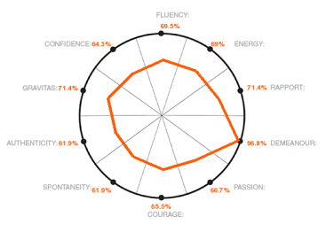
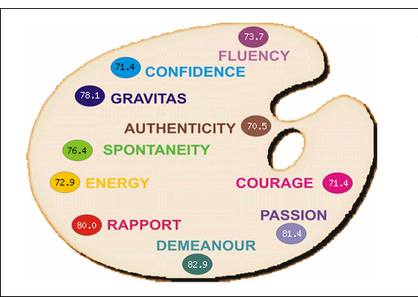



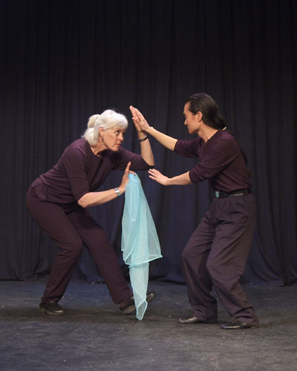
Tentative PERSONAL IMPACT Journey
3
Reading the Book
2
1
Personal Impact Profile
Profile Debrief Call
2- Day Personal Impact Workshop
4
7
Implementation Day
5
Goal Tracking
6
One on One Coaching

Slide 7

1
The Personal Impact Profile
Online Assessment
Each participant and up to 5 of their chosen “supporters” complete an online assessment which will have a set of questions regarding their Personal Impact. They will each need to take out approximately 12 to 15 minutes to complete this assessment.
This MLA (PI) profile gives valuable feedback on ten key behaviours, to see how many colours one is using from his/her palette.

Slide 8
2
Profile debrief call with the consultant
Need of this call – A call with the consultant to discuss the profile, interpret results, decipher statistical facts and free form comments. This is to create a clear vision towards the personal development of the participant during the workshop.
Time - 45 Minutes.

Slide 9
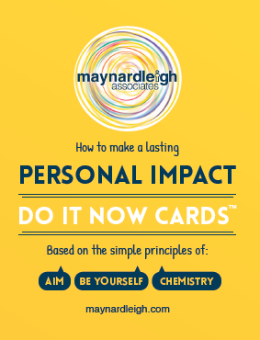
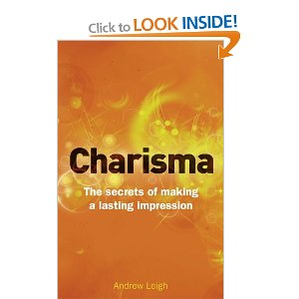


3
Charisma Effect book- Pre-read before workshop
Workshop is supported by
Objectives – Maynard Leigh has a rich heritage of producing some of the best selling publications capturing our philosophies, detailing how we inspire greater impact. Charisma Effect is one such publication, now translated in over 30 countries. A simple to read book unraveling the secrets of making a lasting impression.
Participants receive a copy of this book before the workshop to study relevant chapter/s corresponding to areas identified as their strengths/development needs from the Personal Impact profile.

Slide 10
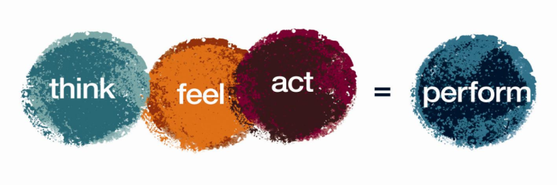
4
Personal Impact Workshop Objectives
Here is a sample of how we frame our objectives before we deliver a workshop.
Think
Being authentic and true to my values is magnetic
By clarifying the impact I want to have, I have more chance of meeting it
I am making an impact at every moment- consciously and unconsciously
Everything makes an impact- my dress, entrance, body language, voice
I have the tools to impress and establish credibility/ authority
Every interaction, presentation is a moment of impact, I will make them count.
Sample
Feel:
Confident in leading conversations
More aware & assured about myself
More present to my audience
Connected to your own true self
Equal with people around me
Capable in influencing outcomes of meetings/discussions
Be more able to:
Engage with a leader in compelling con
Express my opinions and points of view
Convey gravitas and natural authority
Increase ability to gain buy-in and create impact through increased personal presence/charisma
Be alert to what’s going on around you
Impress and establish credibility
Build relationships with Clients, seniors and peers

Slide 11
4
Tentative Workshop Content – Day 1 – Personal Impact
(8 participants per batch)
Session | Session details | Methodology | Objective targeted in this session
Introduction | Welcome and context setting Maynardleigh & participant Introductions Permissive Encouragement – Play & Express yourself | Theatrical warm ups Experiential Context setting
Prepared communication | Participants present their 2 minute prepared communications. They will be asked to come prepared with this before the workshop. | Participant presentations.
The first impression | What creates the first impression Observe, Perceive wonder Receiving feedback on my impact Understanding the nature of impact | Participant led mutual feedback exercise. Facilitator led impact exercises. | Make a good first impression Articulate adequately in all channels (virtual and in person)
AIM | Clarifying objectives. What is the purpose of any communication? What would a positive outcome look like? Working with purpose and performance objectives. Structuring communication for Impact | Facilitator led presentation. Participant exercises. | Be Precise and Impactful in delivering message. Structure Communication .
Be Yourself | Physical Self. - Improving Stature Feeling high status and exhibiting high self esteem. Exhibiting confidence. | Practical exercise Participant practice | Establish credibility/ authority. Communicate with assertion and confidence.
Projecting quality | Recognizing & branding my personal quality. What is the point of me? And What is my Point of view? | Participant led self branding exercise | Check & Identify own tendencies & behaviors. Connected to own integrity.
Closing | Participants finalize what they will START doing, STOP doing & CONTINUE doing. Goodbyes | Action planning Completion

Slide 12
4
Tentative Outline Day 2 – Personal Impact (8 participants per batch)
Session | Session details | Methodology | Objective targeted in this session
Hello! & Recap | Recap of Day 1 & Participant peer coaching partnerships created for the rest of the day.
Chemistry | Attention - Choosing where to focus. Focusing attention on the other person or people. Interdependence - Working creatively in partnership and collaboration with others.. Rapport - Mirroring and developing sensitivity to others, Developing empathy, Understanding the other person. Understanding different global cultural nuances | Facilitator psychodrama Participant exercises | Capable in influencing outcomes of meetings/discussions Comfortable in influencing people and teams. Follow global protocols in interaction Building rapport with stakeholders
Chemistry DNA | An activity to see how we communicate in changing circumstances & challenging situations. Do we look to engage & energize? Do we coach & develop? Or does it all take the sidelines when deadlines and challenges approach? (Looks deceptively simple but tests the water very easily !!) | Highly engaging team activity. Interactive, relevant and impactful facilitator insights | Feel equal with people around. Building rapport with stakeholders. Communicate with assertion.
The balancing act in communication | Communicating to care for results, quality & emotions. Challenges to finding the balance. Not a win-win but purposeful choices | Facilitator & participant based discussions. | Capable in influencing outcomes of meetings/discussions. Comfortable in influencing people and teams.
Personal Challenges | Listing personal challenges around chemistry & balancing act. These will be addressed using interactive theatre | Participant make “Chits” of challenges faced. Interactive theatre & Facilitator coaching | Capable in influencing outcomes of meetings/discussions Comfortable in influencing people and teams. Feel equal with people around
Choosing Goals & Closing | Participants finalize what they will START doing, STOP doing & CONTINUE doing. Finalizing the Goals to work on. Goodbyes | Finalizing goals that each participant would work on.

Slide 13

Ambience
We love alternative ways of setting up a workshop! Creating an atmosphere where the participants feels absolutely comfortable and yet challenged. In this workshop, the use of theatre, team games and experiential methodologies are essential ingredients, hence we’d require ample place to move around and make noise.
Please book a space with ample natural light (Yes, we want sunlight streaming in) and no fixed furniture for 8 Participants to work with one MaynardLeigh consultant.

Slide 14
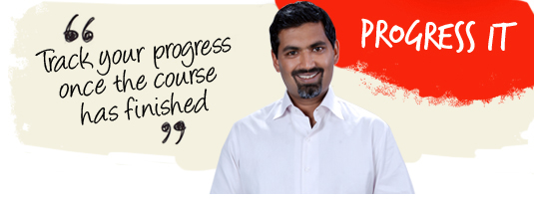
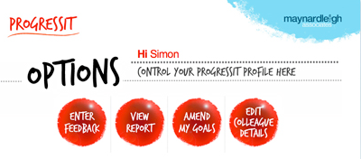
5
9- Week Goal tracking system
ProgressIt ® is a powerful on-line support system that provides follow through after a course, a workshop or learning event. We use this innovative service to:
Help participants reach their self selected behavioural goals
Show line managers what their colleagues have learned and report on the business results from their new learning
Enable Human Resources departments to offer evidence of specific business gains stemming from a particular learning experience.
Assign supporters to these participants who will give feedback for a period of nine weeks.
ProgressIt ® tackles these with a nine-week support service and a report at the end summarizing progress.

Slide 15
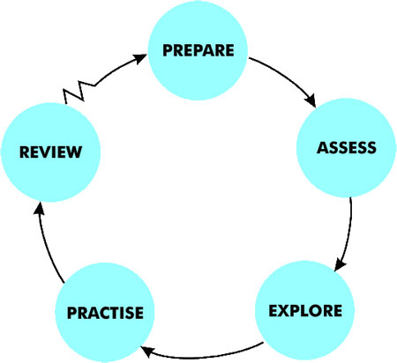
6
One on one - Coaching Sessions
In-Person coaching
We suggest 2 In-person coaching sessions for each participant for 60 Minutes each during the journey. (The 42 international participants will get on a Skype/Video call with the consultants)
Maynard Leigh coaches possess particular skills in creating a safe place in which to practise new ways of thinking and behaving.
The Maynard Leigh performance coaching experience resembles the relationship between a theatre or film director and an actor. The director’s job in rehearsal is to unlock the actor’s potential in order to deliver outstanding performance. They do this in many ways using insightful feedback, suggesting exercises, encouraging experimentation and working in a creative partnership. This is why actors will always expect to get up on their feet and try things out in the rehearsal stage of a production
These sessions will allow the coach & the executive to delve deeper into the area of development and as the sessions progress they will be better suited to practise the learning and revisit what worked & what could be better . Coaching makes a huge impact.

Slide 16
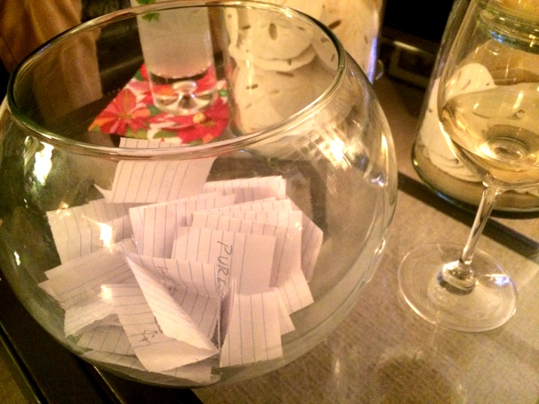
7
Implementation Day
Implementation Day
The 8 participants meet again in September to discuss, practise, share & coach each other in the areas that they found difficult to implement from the workshop.
We ask participants to put challenging situations/stakeholders on chits and drop them in a fish bowl to ensure anonymity. We pick one scenario after another and the facilitator creates an active learning space to simulate, practice and rehearse ways to overcome challenges.
Duration 1 day
1 Maynardleigh facilitator with 8 participants.

Slide 17

Next Steps
Diagnosis Meetings- Given we are to schedule this workshop in January, it is imperative to schedule the diagnostic meetings over the next month.
Booking the workshop venues/Dates- You will need to book 10 workshop rooms and we need to book dates for 10 of our consultants. We’d need to immediately schedule these to ensure availability at both our ends.
Expedite – We’ve finalized the commercials with your procurement team, we will need to expedite the contracting and PO process.

Slide 18
Program Plan
Date | Day | Activity | Responsibility
10-Jan | Tuesday | Share the diagnostic meetings slots | MaynardLeigh
11-Jan | Wednesday | Participant Profile Sheet with Participants details | Genpact to send us the sheet by 11th Jan
12-Jan | Thursday | Genpact to share the the confirmed meeting slots for Diagnosis | Genpact
12-Jan | Thursday | Initiate Personal Impact Profile for all participants | Maynardleigh - We will send an introductory email to Participants about Personal Impact Profile , they would also receive an auto generate emails from the online tool.
12-Jan | Thursday | Coaching Call Schedule to be sent | MaynardLeigh shall send the coaching call schedule with the timeslots and batches accordingly
16-17 January | Monday and Tuesday | Diagnostic Meetings are scheduled | MaynardLeigh consultant spents two days meeting target participants, Genpact to manage the logistics.
19-Jan | Thursday | Charisma Effect Books couriered | MaynardLeigh, we shall courier the Charisma Effect to the Genpact office which is to be handed over to the participants before the Coaching calls
23-Jan | Monday | MaynardLeigh- Workshop design presentation | MaynardLeigh presents the workshop timelines to Genpact stakeholders
23-Jan | Monday | Final Coaching Call Schedule to be received | Genpact to schedule the calls and send the final schedule to us
30th Jan- 3rd Feb | Whole week | Coaching calls to be conducted by facilitators | Genpact & Maynardleigh (Coordination)
21st & 22nd Feb | Tuesday & Wednesday | Personal Impact Workshop | Venue, Lunch arrangements , things required for the workshop to be taken care by Genpact.
21-Feb | Tuesday | Progress IT – Online Goal Tracking Mechanism initiated | Maynardleigh sents the mail to the participants. Participants enter their goal post the workshop on 22nd/23rd Feb
9th March | Thursday | In-Person Coaching Session Schedule to be sent | Maynardleigh
20th March | Monday | Final Coaching Session schedule to be received | Genpact
To be decided | To be decided | One on One Coaching Session | Genpact & Maynardleigh (Coordination)

Slide 19
Your Investment
Investment for One batch of The Personal Impact Journey with 85 Participants
Design and Diagnosis (One time investment) Two-consulting days for Diagnosis Interviews One-day customization of the workshop content | Rs. 30,000 X 2 Days Rs. 30,000 X 1 Days | Rs. 90,000/-
Pre- Workshop- Pre- program Personal Impact Profile Charisma Effect Book, Do-it-Now Cards and workshop Material One-on One Coaching Call (45 minutes with each participant) | Rs.400 per participant X 85 Rs. 880 per participant X 85 Rs. 4500 per Participant X 85 | Rs. 34,000/- Rs.74,800/- Rs.3,82,500/-
Workshop Delivery Charges Professional Fee for delivery (8 Participants per batch - 10 Batches X 2 Days) In-person Coaching Session For participants in India (43 Participants) [2 sessions per participant for 60 minutes each] Skype Coaching for participants located outside India( 42 participants) [2 sessions per participant for 60 minutes each] Progress IT- Online Goal Tracking System Implementation Day (10 Batches X 1 day) | Rs.55,000 Per day Per Consultant X 20 Consulting days Rs.8,000 Per Coaching Session X 2 X 43 Participants Rs.5,500 Per Coaching Session X 2 X 43 Participants Rs.200 per participant X 85 Rs.55,000 Per day Per Consultant X 10 Consulting days | Rs.11,00,000/- Rs.6,88,000/- Rs.4,62,000/- Rs.17,000/- Rs.5,50,000/-
Total Investment for this journey Total Investment per GOLD Leader |  | Rs. 33,98,300/- Rs.39,980/-

Slide 20
Commercial Terms & Conditions
Client is responsible for providing venue, conference facilities, AV equipment.
Travel outside Delhi NCR - Air, stay & airport/ venue cab transfers to be taken care by the client.
Travel inside Delhi NCR - at Rs. 12.00 Per Km.
Not inclusive of applicable taxes (service tax @ 15%).
A commercial contract will be signed before the execution of the project.
50% of cancellation fee will be charged on any cancellation or postponements that occur within 20 working days of the confirmed date of delivery.
The above commercials are valid till the 31st March, 2017
Contracts, legal & accounting paperwork (including billing & payments) will be in the name of “Life Strategies Humancare Pvt. Ltd.”

Slide 21
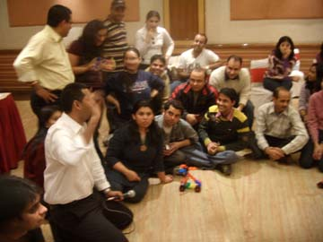
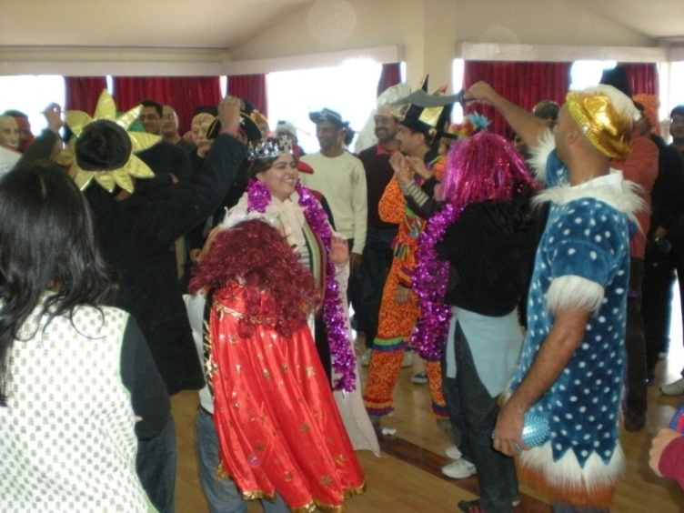
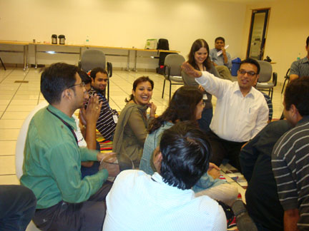
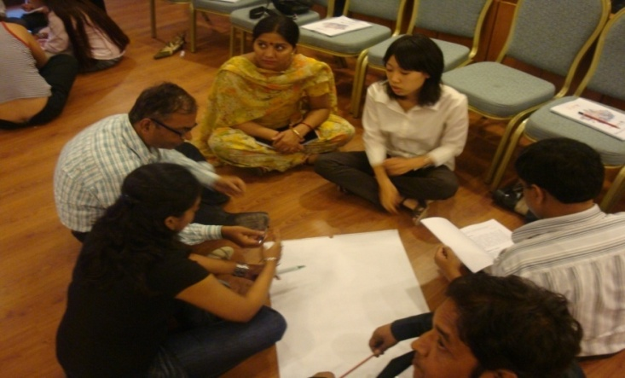

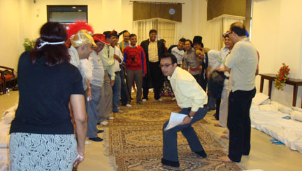
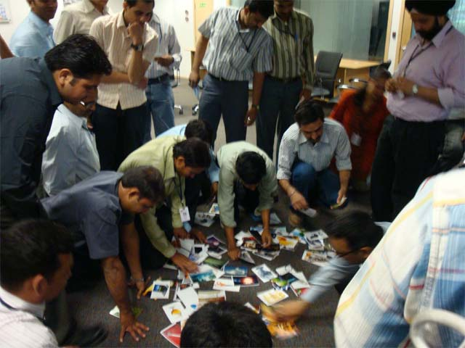
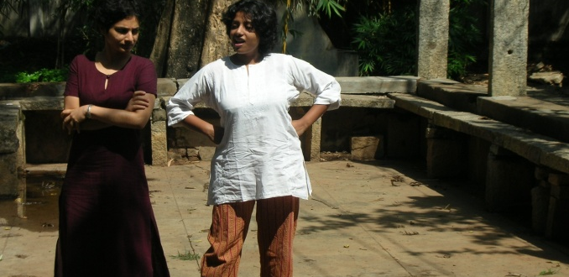
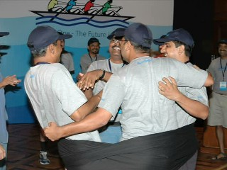
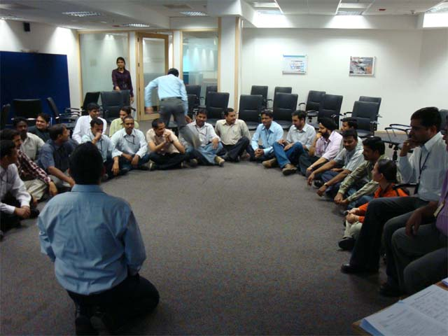
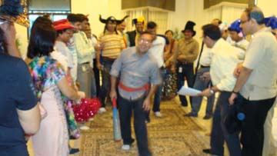

Slide 22













































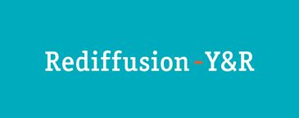









Our Clients
Notes:
22

Slide 23


Let’s work in partnership to create impact & unlock potential
For further information please connect with:
Contact Jigyasa Sharma/ Varun Gupta
Email jigyasa@maynardleigh.in/ varun@maynardleigh.in
Telephone +91 97179 22445/ +91 9560192443

